Slide 1

AwesomeDT
Awesome Query language
A new Language for Custom activity on Data table manipulation in simple text using UiPath

Slide 2
Problem Statement
AwesomeDT
UiPath RPA Developers ,
Daily working with Data Tables (Table in Memory ), Data Table might be out put of Excel File (Read Range) or Might be Structure Data From Web or Output of CSV File or Output Of DataBase.
Developers do data table manipulation's based on business requirement, its like
Remove Duplicates
Sort Order
Merge Multiple Data Tables
Filter Data Table using Criteria
Create New Custom Columns
Select Top N Records
Interduce Serial Number Column …etc.
To Satisfy this type of Business Requirement Developers have to use Lot Of Code and it is Time Consuming Process and not user friendly

Slide 3
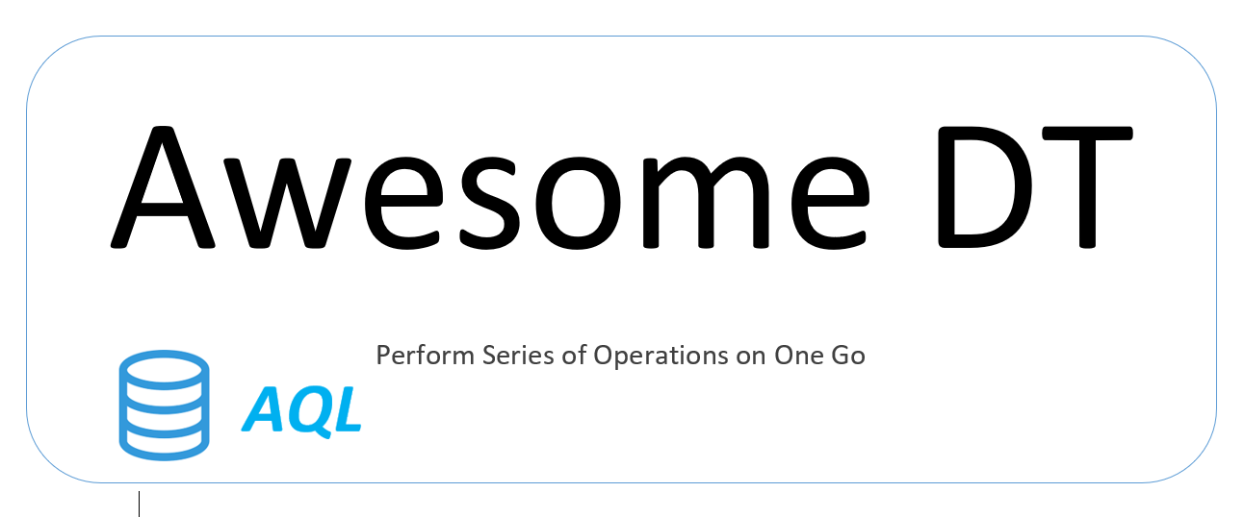
AwesomeDT

Slide 4

Solution is here
AwesomeDT
Using AwesomeDT Custom Activity, RPA Developers can Perform Series Of Data Table Operations on One Go with very less development time
Development Time Reduces from
Hours -> Minutes

Slide 5
Awesome Query Language
AwesomeDT
Create Consolidated Data Tables merging a list of multiple data tables where we can also
Dynamically Create new columns on the fly
Apply filter based on some conditions
Sort the data table by desc, asc
Top N Rows
Apply Excel formula on the fly
Remove duplicates
Create New Serial Number Column
Etc.…

Slide 6

How to Use
AwesomeDT
Input Parameters
InputDTList : (List<DataTables>)
AQLString (String)
Output Parameters
ResultDT (Data Table)

Slide 7
AQLString
AwesomeDT
1+2+3 | Remove-Duplicates | where Salary > 40000
O/P
I/P
O/P
I/P

Slide 8
Awesome Query Language
AwesomeDT
Name | Syntax | Example | Description
Merge | DT1+DT2+DT3+DT4 | 1+2+3+4 | Using Mathematical Operators Like (+) Plus Easily Do Merge
Remove Duplicate Rows | Remove-Duplicates | Remove-Duplicates | It will remove all duplicate rows from the input data table
Select Specific Columns | Select [Column List] | Select Employee, Salary, Department | Select only specific columns from the data table
On the Fly Columns | Select [new Column Name] = [Formula] | Select Price, Qty, Total=Price*Qty | Can apply any formula or expression using header names
Filter | Where [Column Name] (Operator) [Value/Expression] | Where Salary >50000 | By using where keyword can use all kind of filter conditions like <, >, >=, <=, StartsWith, EndsWith, IsEmpty, Contains, Not Contains
Top N | Top N | Top 10 | It will show top 10 rows from the Data Table
Auto Increment (Row Num) | [Column Name] =Row ([Column Name]) | Select SNo=Row(SNo) | On the fly Row Number will generate with auto increment by 1
Excel Formulas | Select [New Column Name] =[Excel Formula] | Select EmployeeLength=Len(Employee) | Apply any excel formula with column headers
Order By | Order By [Column Name] [OrderType] | Order By Employee Desc | Arrange data table using column any order type (Descending / Ascending) By Default its Ascending Order)

Slide 9
AQLString
AwesomeDT
Let’s say there are 3 different data tables with same schema then we can apply a series of operations as mentioned below using this custom activity
1+2+3 | Remove-Duplicates | where Salary > 40000 | Order By Salary Desc | Select SNo=Row (SNo), FirstName, LastName, EmployeeName=FirstName&LastName, Salary, EmployeeType , YearlySalary =Salary*12 | Top 5
Note: the above use case is just an example to show that we can create any such series of operations on the fly with this custom activity
In general, the same series of operation will take around 8 to 10 hours if performed manually. With this custom activity it will take just take few seconds to form this query using AQL.

Slide 10
AwesomeDT
Demo

Slide 11
AwesomeDT
Thank You

